Slide 1
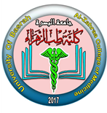
University of Basrah Al-zahraa medical college
Ministry of higher Education
and Scientific Research
The module: Mechanism of Disease
Session 5 / Lectures 2
Haemostasis and Thrombosis (I)
Module staff: Session 5
Dr. Sadiq K. Ali (Module leader)
Dr. Ihsan Mardan
Dr. Iman Abdul-Hadi
Dr. Ghada Lateef
Dr. Wasan Mansur
Dr. Safa Asaad
Robbin’s Basic pathology 9th edition
Hoffbrands Essential Haematology 7th edition

Slide 2
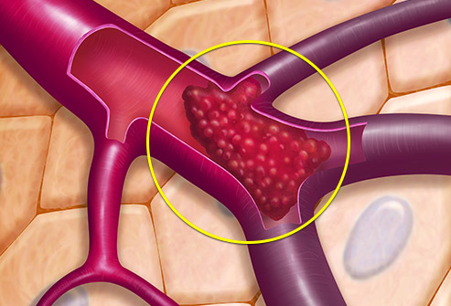
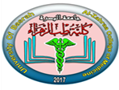
University of Basrah Al-zahraa medical college
Ministry of higher Education
and Scientific Research
Session 5
Lecture 2
Thrombosis

Slide 3
University of Basrah Al-zahraa medical college
Ministry of higher Education
and Scientific Research
Learning objectives:
Haemostasis;
Definition
Balance of coagulant and anticoagulant factors
Intrinsic and extrinsic pathways
Role of platelets
Fibrinolytic system
Thrombosis;
Definition
Predisposing factors
Effects of thrombosis
Outcomes

Slide 4
2- THROMBOSIS
The pathologic counterpart of haemostasis is thrombosis, the formation of blood clot (thrombus) within intact vessels.
The three primary abnormalities that lead to thrombus formation (Virchow’s triad):
(1) endothelial injury,
(2) stasis or turbulence of blood flow, and
(3) blood hypercoagulability

Slide 5
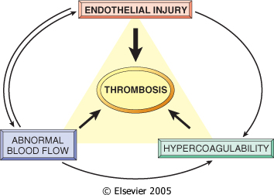

Slide 6
Endothelial Injury
Endothelial injury is an important cause of thrombosis, particularly in the heart and the arteries (e.g., thrombi in the cardiac chambers after myocardial infarction)
Dysfunctional endothelium (hypertension) elaborates greater amounts of procoagulant factors (e.g., platelet adhesion molecules, tissue factor, PAI) and synthesizes lesser amounts of anticoagulant molecules (e.g., thrombomodulin, PGI₂, t-PA).

Slide 7
Alterations in Normal Blood Flow
Turbulence contributes to arterial and cardiac thrombosis by causing endothelial injury or dysfunction, as well as by forming countercurrents and local pockets of stasis; stasis is a major contributor to the development of venous thrombi.
Hyperviscosity syndromes (such as polycythemia) increase resistance to flow and cause small vessel stasis; the deformed red cells in sickle cell anemia cause vascular occlusions, and the resultant stasis also predisposes to thrombosis.

Slide 8
Hypercoagulability
It is loosely defined as any alteration of the coagulation pathways that predisposes to thrombosis, and it can be divided into primary (genetic) and secondary (acquired) disorders.
Hypercoagulability contributes infrequently to arterial or intracardiac thrombosis but is an important underlying risk factor for venous thrombosis.

Slide 10
Morphology
Thrombi can develop anywhere in the cardiovascular system (e.g., in cardiac chambers, on valves, or in arteries, veins, or capillaries). The size and shape of a thrombus depend on the site of origin and the cause.
Thrombi are focally attached to the underlying vascular surface and tend to propagate toward the heart; thus, arterial thrombi grow in a retrograde direction , while venous thrombi extend in the direction of blood flow.

Slide 11
Thrombi can have grossly (and microscopically) apparent laminations called lines of Zahn; these represent pale platelet and fibrin layers alternating with darker red cell–rich layers. Such lines are significant in that they are only found in thrombi that form in flowing blood.
Their presence can therefore usually distinguish antemortem thrombosis from the nonlaminated clots that form in the postmortem state.

Slide 12
Arterial thrombi are typically relatively rich in platelets, as the processes underlying their development (e.g., endothelial injury) lead to platelet activation.
Venous thrombi (phlebothrombosis) frequently propagate some distance toward the heart that is prone to give rise to emboli.

Slide 13
Venous thrombosis is largely the result of activation of the coagulation cascade, and platelets play a secondary role. Because these thrombi form in the sluggish venous circulation, they tend to contain more enmeshed red cells, leading to the red, or stasis, thrombi. The veins of the lower extremities are most commonly affected (90% of venous thromboses).
Thrombi on heart valves are called vegetations.

Slide 14
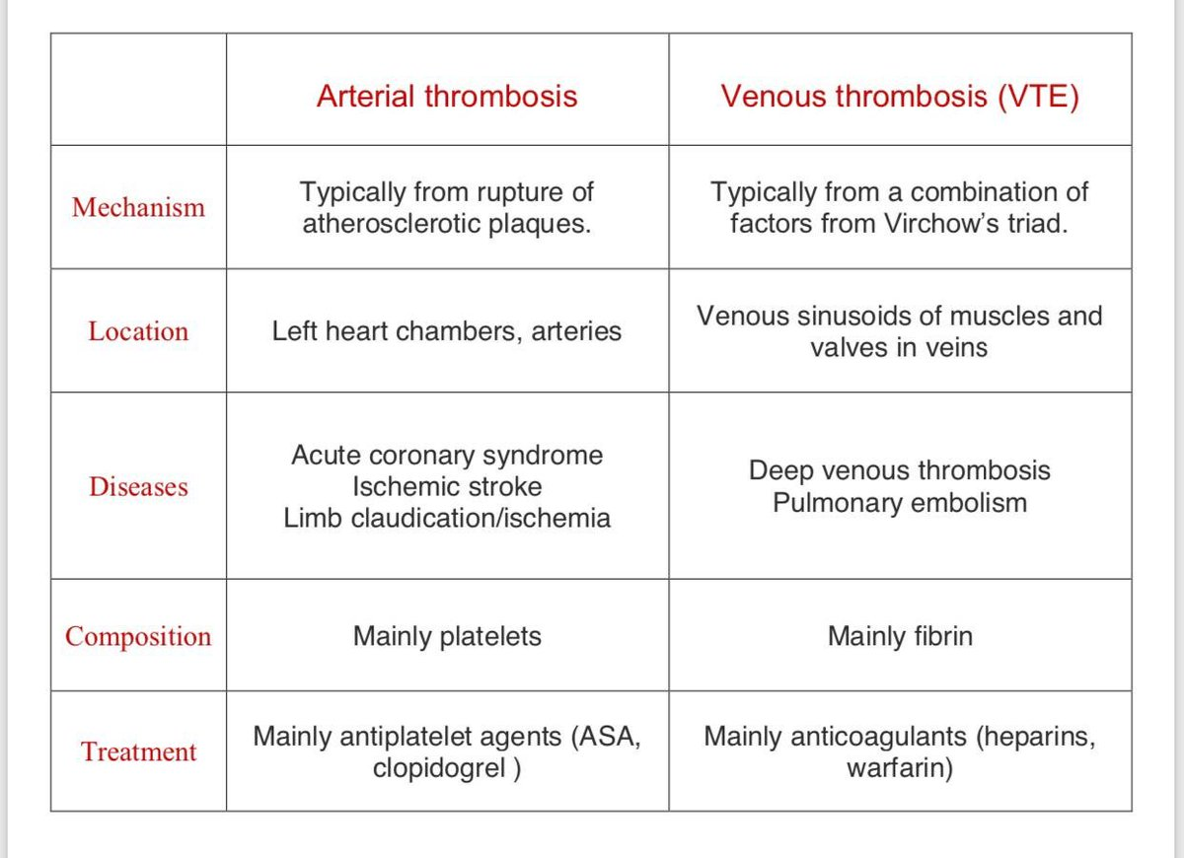

Slide 15
Fate of the Thrombus
Propagation.
Embolization..
Dissolution.
Organization and recanalization.

Slide 16
Fate of the Thrombus
Propagation: The thrombus enlarges through the accretion of additional platelets and fibrin.
Embolization: Part or all of the thrombus is dislodged and transported elsewhere in the vasculature.
Dissolution: If a thrombus is newly formed, activation of fibrinolytic factors may lead to its rapid shrinkage and complete dissolution.

Slide 17
Fate of the Thrombus
With older thrombi, extensive fibrin polymerization renders the thrombus substantially more resistant to plasmin-induced proteolysis, and lysis is ineffectual.
Therapeutic administration of fibrinolytic agents is not effective unless given within a few hours of thrombus formation.
Organization and recanalization: Older thrombi become organized by the ingrowth of endothelial cells, smooth muscle cells, and fibroblasts into the fibrin-rich thrombus.

Slide 18
